Slide 1
Design Review 3
WBS
Aseel Yousef, Xiaohan Liu, Lihua Diao,
Ethan Gage

Slide 2
Introduction
Team Touch Base:
Adapting a passive prosthetic from the Flagstaff E-Nable chapter for active control with a feedback system. Working with an ME team to split development between hardware, software, wiring, and 3D printing.
Client: Dr. Winfree GTA Mentor: Demetria
Ethan

Slide 3
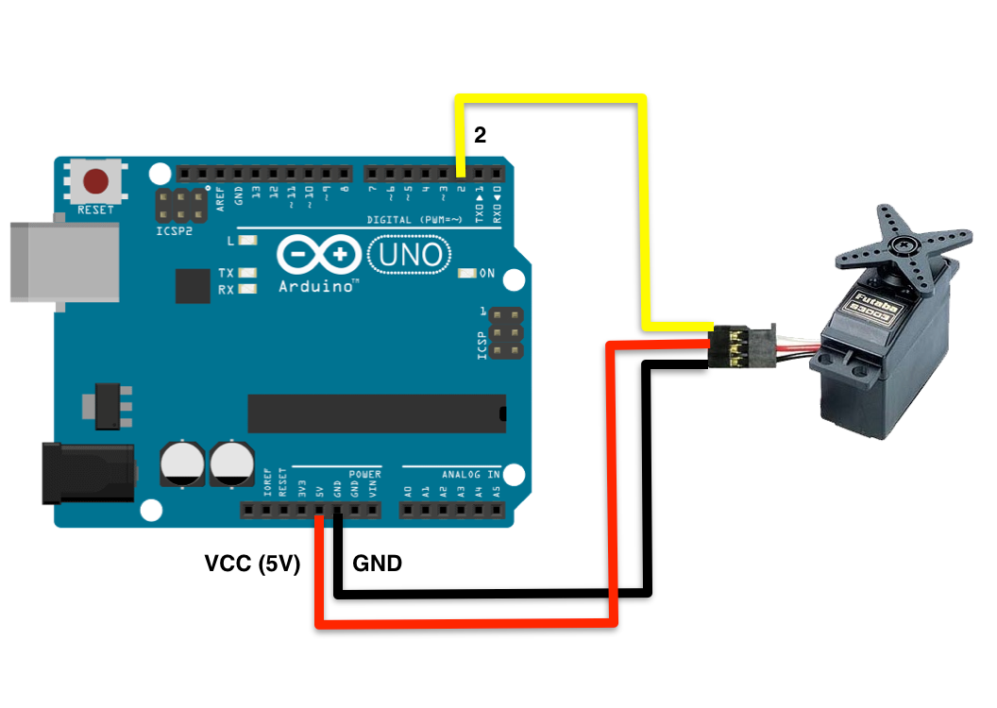
WBS Aseel
Pressure feedback
Feedback Motor control circuit
Arduino code
Constricting band
Servo motor
Pressure sensor
Servo control
A constricting band indicates a firm grip
An expanding band indicates a loose grip
Finalizing the subsystem
Get more pressure sensors
Get the pressure sensor working
Aseel

Slide 4
WBS Ethan
Muscle Sensor Subsystem
Build and design circuit, sensor side
Arduino code for Muscle Sensor / non-linear mapping
Aseel supplies Motor Control code
Toe-to-Thumb Subsystem
Circuit Design for Xbee setup, motor side
Arduino code for Xbee packet decoding
XCTU Setup for XBee communication
Lihua handles sensor side code/design
Working with ME team for XBee communication
Capstone Website
Basic outline
Worked on with Xiaohan
Ethan

Slide 5
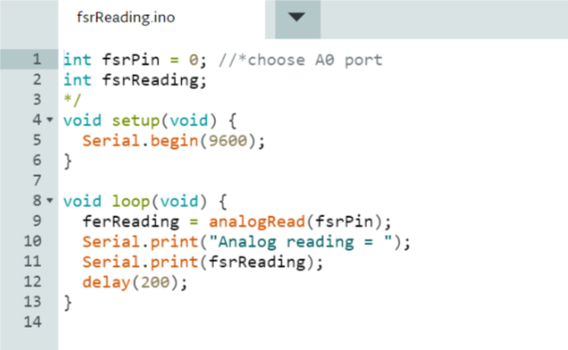
WBS Lihua
Toe-to-Thumb controls circuit
Breadboard
Arduino
FSR pressure sensor
Resistance
Toe-to-Thumb pressure sensor Arduino code
Data measurement: FSR pressure sensor
Data transmission: XBee (Ethan)
Code for fsrReading
Lihua

Slide 6
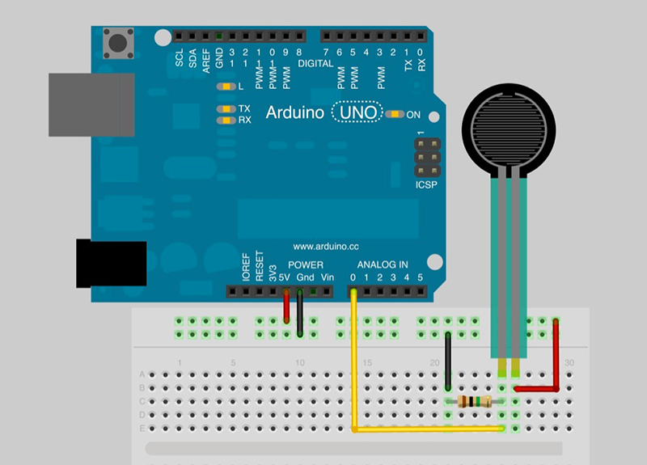
WBS Xiaohan
Website Outline
Netbeans
Worked on with Ethan
Pressure Sensor Circuitry for Toe to Thumb control
Worked on with Lihua
Breadboard
Arduino
FSR pressure sensor
Resistance
Xiaohan
Notes:
Website: Ethan listed outline and I made HTML design and layout. A good interface can attract more people to understand this project. For example,put the team logo fixed on the top of the homepage, Set clear menu to find each subsystem immediately, made some simple animations to show the group member's email and so on. I write code in netbeans and test in Microsoft Edge Browser.
I also did pressure sensor part with Lihua, This is the circuit. A FSR pressure sensor , a 10k ohm resistance, and arduino. The circuit is basic and simple, it just for measure the pressure value and enable to make some process.

